Slide 1
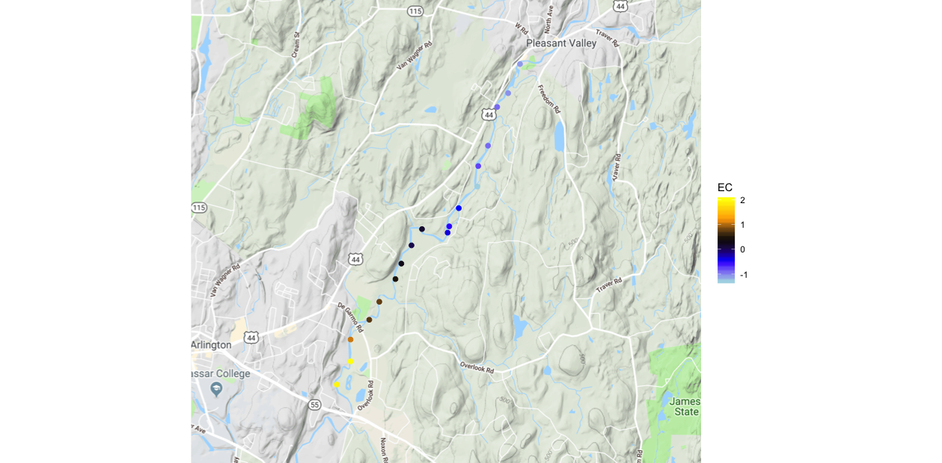
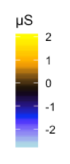
Reach Normalized Specific Conductance (μS/cm)
Zone 2-1
High Angle
Fault Zone
Zone 2-2
Contrast B
1.0
2.0 Km

